Slide 1
I Need a </ br>
Notes:
Team Name

Slide 2
OUR TEAM
Benjamin
Christine
Sujith
Yi Lin
Notes:
Introduce Team Members

Slide 3

01 Concept
Notes:
Intro slide, just click next

Slide 4
PROBLEM
SOLUTION
With recent event of global pandemic, your whole gym routine and schedule are thrown off and with restriction slowly lifting away, people will be getting back at it. However you would need a new routine and schedule to get back to where you were.
?
Notes:
Motivation for our development

Slide 5
Personal Fitness Planner
Generate your personalized fitness plan according to your fitness goal.
Notes:
Solution – Product Name and One liner for the App.
Explain some of the user stories:
As a User you want to be able to log in to my Account to see my plan
As a User I want to select my Fitness plan schedule (days and weeks) and type (Body Parts)
As a User I want to see my Planner with weeks and days
…More features be shown on the Demo ;)

Slide 6
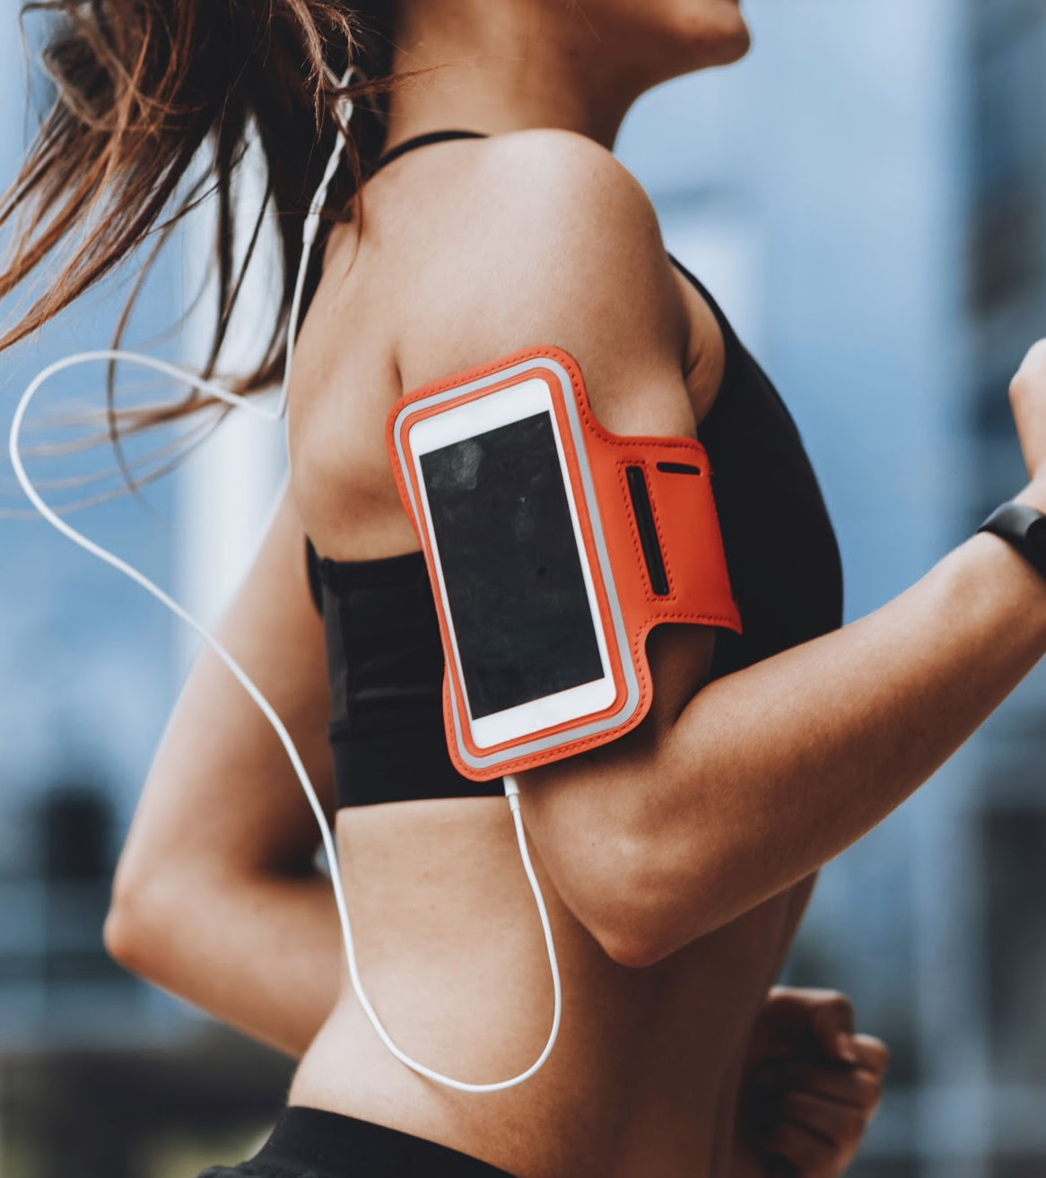
02 Process

Slide 7
Core Technologies
jQuery
JavaScript code that is implemented
Zurb Foundation
CSS Framework
API
Wger – Workout Manager Quotes free API
Google Font & Font Awesome
Styling used for user experience
Notes:
Core Tech used in our Project

Slide 8
Project Timeline
Research on API and CSS Framework, build base Html layout
02
01
Create WireFrame and User Stories
Further JavaScript Development and Completion of Initial Pages
04
03
Use CSS Framework and Add Styling to the page, begin JavaScript Development
Finalise Application, Testing and Bug Fixes, and End to End Run Through of the Application
05
06
Application Pitch and Submission
Notes:
1. Create WireFrame and User Stories
2. Research on API and CSS Framework, build base Html layout
3. Use CSS Framework and Add Styling to the page, begin JavaScript Development
4. Saturn is composed mostly of hydrogen and helium
5. Finalise Application, Testing and Bug Fixes, and End to End Run through of the Application
6. Application Pitch and Submission

Slide 9
Task Management
Collaboration Tree
Sujith
Christine
Yi Lin
Benjamin
Project Management
UI/UX Design
UI/UX Design
API Functionality
UI/UX Design
JavaScript for Setting Page
JavaScript for Planner Page
JavaScript for Planner Page
JavasSript for SignIn Page
Notes:
We had our individual tasks and as Team we resolved blockers and collaborated in passing the information or just small functionality that doesn’t interfere with their core code.
Examples – Navigation or pages, Colour changes for completed workout, Storing settings and exercise information.

Slide 10

Challenges
API documentation quality was very poor, and incorrect Key was provided
Learning new CSS framework and how to implement them
First experience at collaborating with each other on GitHub
Successes
Managed to analyse the Wger API so that it can be utilised in the application
Once studied, we were able to use many of the components
Only had two conflict cases, and worked well with each others code

Slide 11
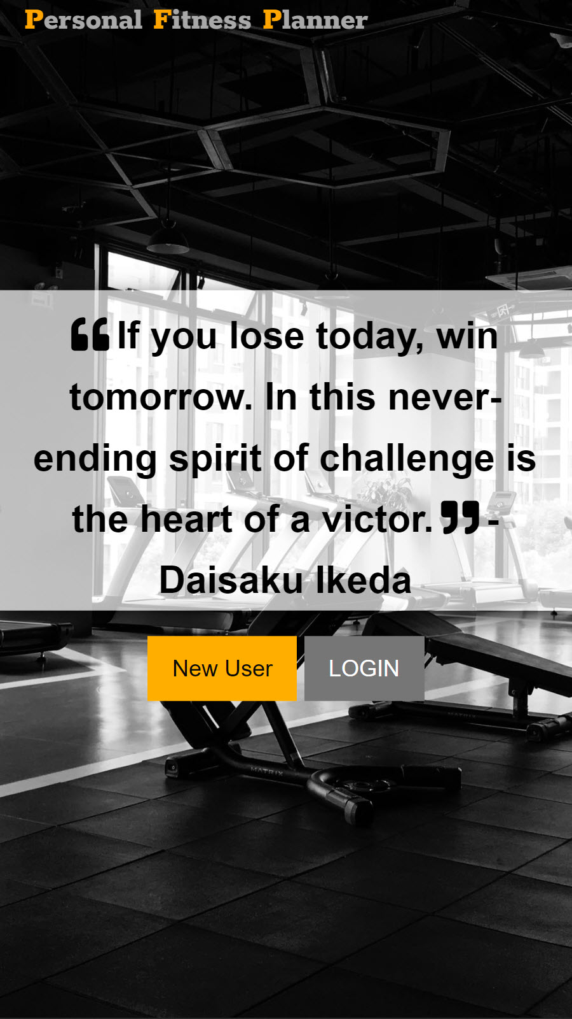

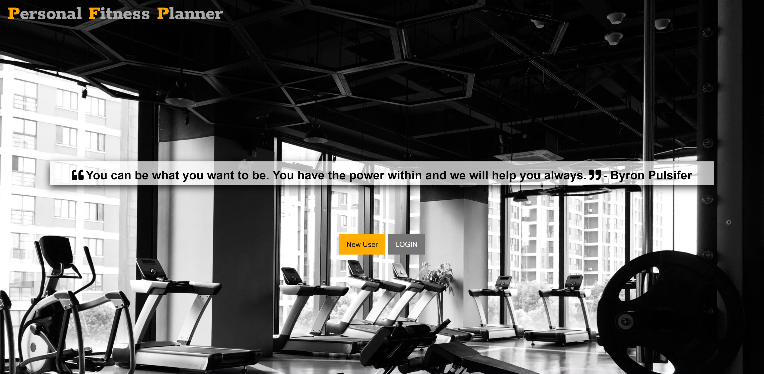
Application Screenshot
Mobile Friendly
Desktop View

Slide 12
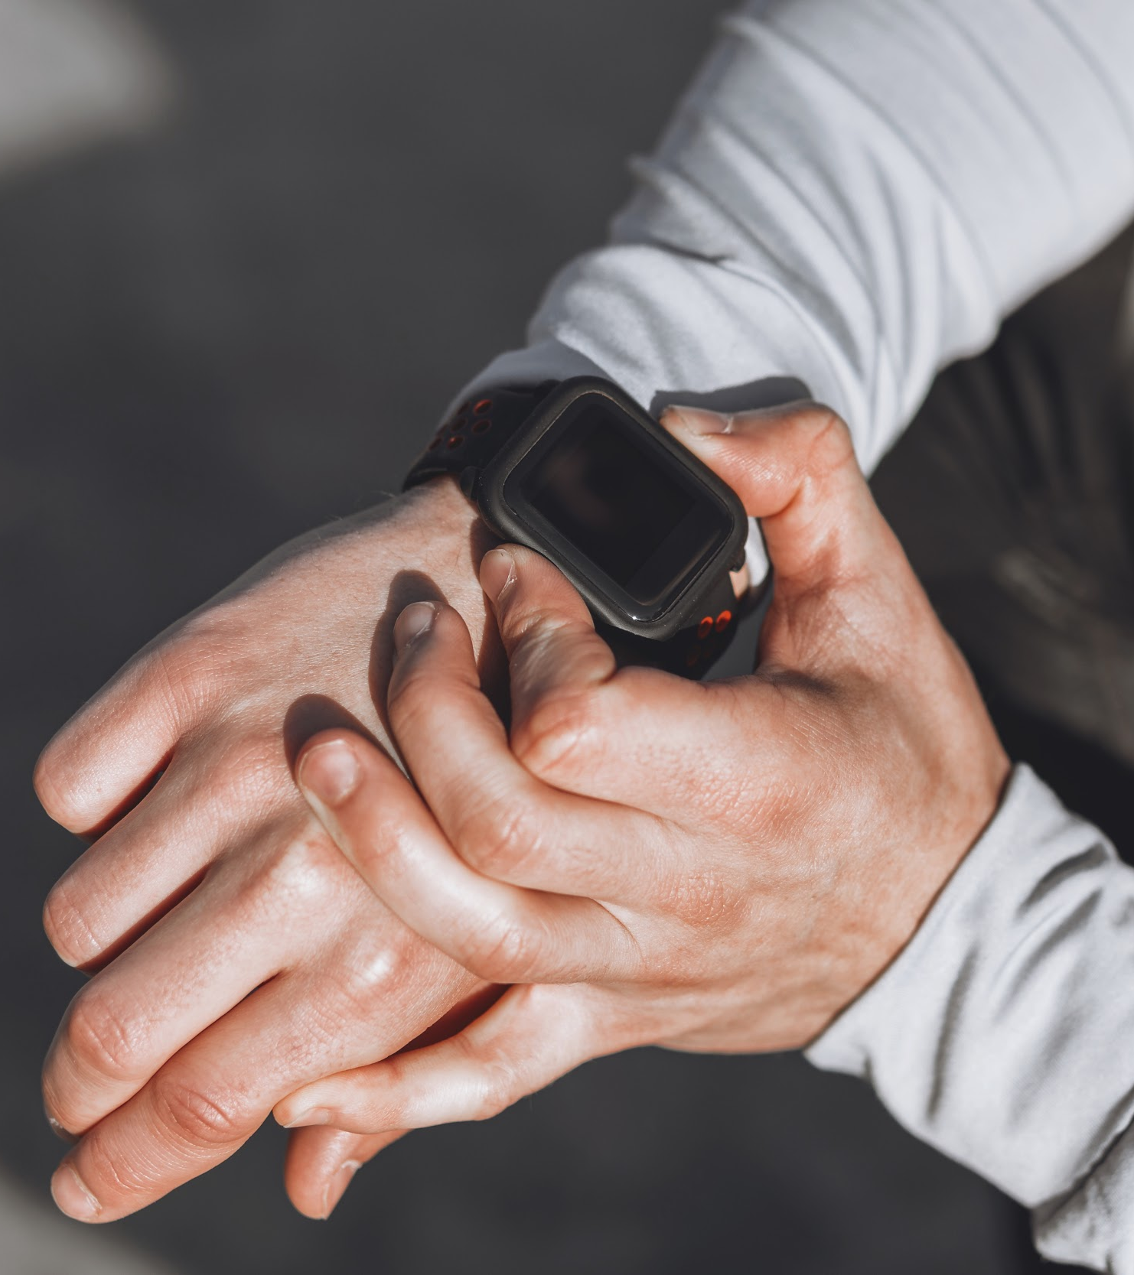
03 Demo

Slide 13
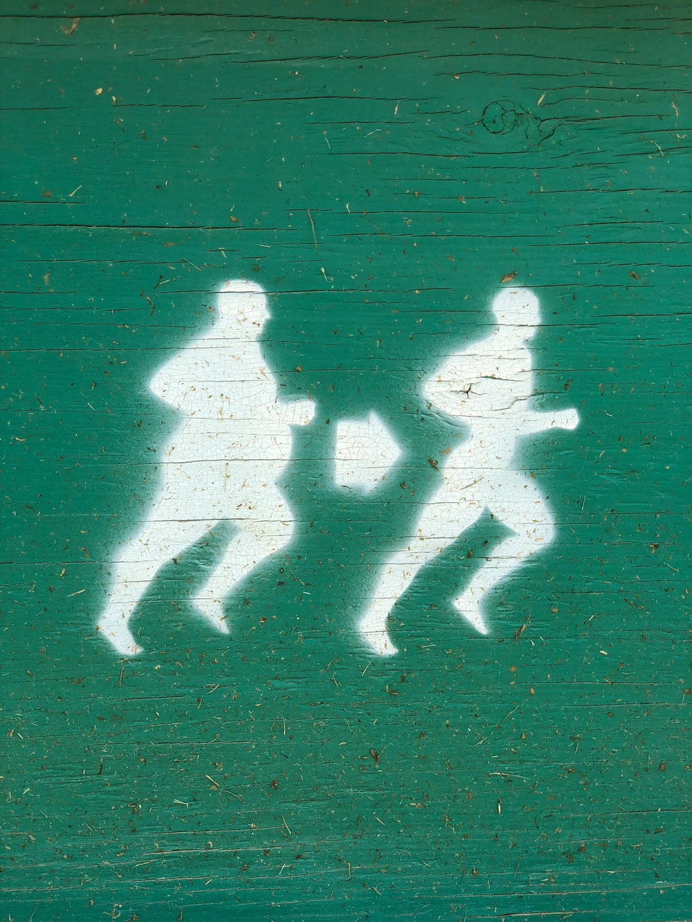
04 What’s Next

Slide 14

Future Development
Current Limitation
Phase X
App is tied to the machine
API has limited variety and creditability of exercises is low
Using Database to store and retrieve information
Further improvement on narrrowing down the user prefrence
Better API’s
Notes:
Read out Main Limitation and Future Improvement (phase X) and talk about rough user features like syncing to your apple watch etc.

Slide 15
THANKS!
Do you have any questions?

